Slide 1
Software core modules
Summary - Draft
2020-05-12

Slide 2
Table of contents
Data Model Concepts
Coordinate Systems
3D Transformations
Configuration file
User Interface

Slide 3
Typical Application Objectives
Primary Objective:
Acquire distance and tracking information from the ReceiverCapture objects
Secondary Objectives:
Evaluate distance and speed relative to the ReceiverCapture object, as well as from other coordinate points (ex: from car or world coordinates).
Position detections in space
Facilitate asynchonous integration with application components

Slide 4
CORE Library Objectives
The Core elements of the library provide user-interface independent functionalities:
Acquiring data from the physical AWL units *(ReceiverCapture and derived classes).
3D coordinate calculations (CoordinateSystem.
Integrating above concepts in the physical configuration of the application (ReceiverPostProcessor and AWLCoord)
Allow the application to manage threaded and application controlled loops (TheadedWorker and LoopedWorker)
Establishing a Publisher/Subscriber mechanism for user interface objects wishing to access data asynchronously (Publisher / Subscription)

Slide 5
Class Groups
Data support classes
Detection
AcquisitionSequence
3D Transformations
Acquisition classes
ReceiverCapture
Utility classes
Thread and loop management: Worker classes
The publishing model
Settings and comfiguration file
User interface classes

Slide 6
Data Model Concepts
A Receiver (ReceiverCapture) module hosts an array of independent sensor pixels (called Voxels).
A receiver operates at high rate, acquiring multiple frames (SensorFrame) of data in a single second.
A pre-determined number of SensorFrames are stored in a queue (AcquisitionSequence). The storing of an AcquisitionSequence allows the study of the dynamics of the objects detected by the Receiver.
Each channel has the ability to detect multiple objects within a single detection Frame. Each individual detection is placed in a Detection object.
The Receiver also performs a time analysis of the displacement of objects. It reports the « tracked » objects in a separate set of objects (the Tracks)

Slide 7
Data Model Concept (2)
Tracks can describe objects that cover more than one channel. Detections are channel-based descriptions.
The Tracks and Detections are incomplete structures for reporting (due to current receiver software limitations).
A ReceiverPostProcessor is used to produced enhanced Detection information (that will include ThreatLevel information and more complete 3D positioning information). The enhanced information is stored in the Detection object (should be a distinct class: a class separation will be performed in a later version).

Slide 8
Data Model Concept (3)
Most applications will access the ReceiverCapture Data through a ReceiverPostProcessor instance.
The ReceiverPostProcessor:: GetEnhancedDetectionsFromFrame() method provides the enhanced Detections from a specified frame in a convenient Detection::Vector container.
Given the multithreaded nature of the system, Detection data transferred to the application is usually by copy.
Other Applications may choose to access the complete AcquisitionSequence for further analysis, or to access a sepecific SensorFrame.

Slide 9
Data Model Concept (4)
Most of the objects are accessed through
boost::shared_ptr<> Ptr pointers. This allows safer and easier management of the lifecycle of the objects.

Slide 10
Coordinate systems
Object coordinates can alternatively be described as CartesianCoordinates or SphericalCoordinates.
The Coordinate system used throughout the code is a right-handed coordinate system, with the X axis pointing forward.
This can be confusing for some people used to dealing with camera coordinates and requires some care.

Slide 11
Coordinate systems (2)
In Cartesian Coordinates:
X is positive going forward
Y is positive to the left
Z is positive going up
In Spherical coordinates
rho is distance
theta is angle from z axis, clockwise
phi is angle from x axis, counterclockwise
This means that with X looking forward:
Theta: -: Up +: Down
Phi: + Left -: Right

Slide 12
Coordinate systems (3)
In addition to its position, an object in a coordinate frame can have an Orientation:
yaw is a counterclockwise rotation about the z-axis (looking right is yaw negative).
pitch is a counterclockwise rotation about the y-axis (looking down is pitch positive [since Y axis is oriented leftwards]).
roll is a counterclockwise rotation about the x-axis (rolling rightwards is roll negative).
This means that, for a standard reference frame, where X axis is looking forward from the object:
- looking right is yaw negative.
- looking down is pitch positive.
- rolling to the right side is negative

Slide 13
Coordinate systems (4)
The RelativePosition of an object to a coordinate frame constains both a CartesianCoord position and an Orientation
The RelativePosition is also used to describe the displacement between relative coordinate frames in 3D transformations.

Slide 14
3D Transformations
Coordinate transformations are used to convert the position of an object from one coordinate system to another.
This is how, for example, a distance of an obstacle from a sensor in a given channel can be transformed in a position of the obstacle from the vehicle’s bumper, or to world coordinates.
A « tree » of relative coordinate system nodes (TransformationNode) is maintained, that describes the RelativePosition of coordinate systems used:
World
Vehicle
Receiver | Camera
Sensor (Channel)

Slide 15
3D Transformations (2)
The TransformationNodes convert the RelativePosition of the coordinate systems in affine transformation matrixes, that accelerate the calculation of coordinate conversions.
From a given TransformationNode, it is possible to convert to or from another reference coordinate system
Using TranformationNode::ToReferenceCoord() and
TranformationNode::FromReferenceCoord()
The eCoordLevel enum provides helpful in indexes to the most commonly used transformations.

Slide 16
3D Transformations (3)
The coordinate systems of all objects used in a typical ranging application are stored in a configuration file.
The AWLCoordinates class provides a set of static functions to:
Read the coordinates of objects from the configuration file.
Rapidly access the TransformationNode of every object.
Access the RelativePosition of each object
Calculate the most common coordinate transformations
Quick note:
While all angles in the applications are processed in radians, they should be provided in degrees in the configuration file and all user interface functions.

Slide 17
Configuration file
The configuration file is a XML format file.
Once the XML file is read, all applications objects use its boost::property_tree::ptree representation to access its contents.
The AWLSettings object is a utility object that provides:
Initially opens the configuration file and provides access to the resulting boost::property_tree::ptree
Reads and stores some commonly used settings in the application.
Ideally, every object that accesses configuration data should have a constructor or method to retreive the configuration information from the property tree
This insures that the configuration file can contain only information used by the objects created.
This was not yet fully implemented. There is still a lot of UI-level information in the AWLSettings class.

Slide 18
ReceiverCapture
The ReceiverCapture virtual class is the communications and storage interface between a physical LiDAR unit and the computer. Its main tasks are:
Establishing communications with the physical unit, child renclasses are adapted to the specific communications protocols, interfaces and versions of LiDAR units.
Acquiring data from the LiDAR units
Detection data is stored as an AcquisitionSequence.
Reading the operating status flags of the unit (ReceiverStatus).
Managing the operating parameters of the LiDAR units by sending, receiving and storing:
Registers (FPGA, ADC and GPIO registers) – for experimental purposes only
Detection Algorithm parameters.

Slide 19
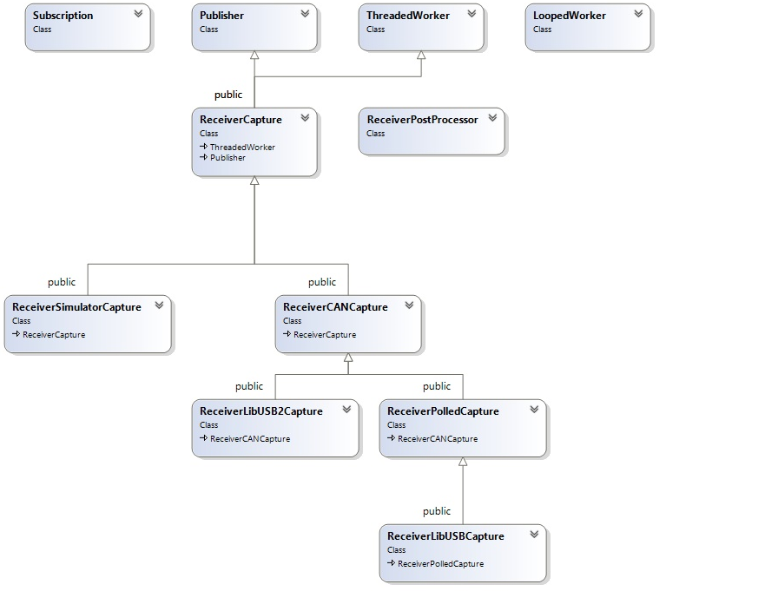
ReceiverCapture Hierarchy

Slide 20
ReceiverCapture (2)
The ReceiverCapture is a threaded class (ThreadedWorker) that acts as a Publisher. A publication is generated by every new frame of data acquired.
Initializing the LiDAR modules (once communications channel is opened):
Most versions of the LiDAR sensors, allow enabling/disabling categories of messages to reduce the load on the data stream. Although receiver units have defaults set for the message mask. the messages transmitted should be explicitly selected by the application to reduce data load.
By defaut, all modules are configured to report all of their sensor channels. This behavior can be altered to report on specific channels only.
The frameRate should be initialized explicitly to insure that it is adapted to application requirements.
The SetMessageFilters() method is typically called by the ReceiverCapture child classes after opening of the communications ports.
Configuration used for initialization is read form the configuration file, when the propoer constructor is used.

Slide 21
ReceiverCANCapture
The ReceiverCANCapture is virtual class, descendant of the ReceiverCaptureClass, that handles all the CAN communications messages through CAN converter.
When using the configuration filefor initialization, the ReceiverCANCapture object will load:
Communications port configuration information
Optionnally will load a default list of FPGA, ADC, GPIO regsiters description as well as detection algorithm default descriptions.
If these descriptions cannot be loaded or are absent from the configuration file, the messages used to control FPGA, ADC GPIO registers and algorithms will not be functionnal (calls will return with no effect).
This behavior may be wished for in a minimal implementation of the modules or application, where only detection data is needed with the default sensor behaviour.
The ReceiverCANCapture uses a generic AWLCANMessage structure for communications. The ParseMessage() method can be used by all descendant classes to support the CAN protocol.

Slide 22
ReceiverCANCapture
Derived classes that wish to implement a CAN interface must define methods for:
OpenCANPort(), CloseCANPort, WriteMessage(), DoOneThreadIteration() and ReadConfigFromPropTree().
To parse incoming messages:
In DoOneThreadIteration(), once a CAN Message has been read and Formatted into a AWLCANMessage,
the derived classes can call ParseMessage() to continue the interpretation of the messages.
In DoOneThreadIteration(), derived classes should also handle the disconnection / reconnection of the CAN port in a robust manner.
To Write outgoing messages:
Write the appropriate WriteMessage() to send an AWLCANMessage to the CAN device.

Slide 23
ReceiverSimulatorCapture
The ReceiverSimulatorCaptureclass is a simplified example implementation if a ReceiverCaptureClass.
It is designed to simulate a set of acquisition data without the presence of a physical device.
Useful while debugging or for application demo purposes.

Slide 24
« Worker » models
AWL application support objects work in applications under two separate models:
ThreadedWorker for objects that run independly of the application in a thread.
LoopedWorker for objects that are explicitly and periodically invoked by the application as pa part of their messaging lopp processing.
Both types of worker objects share a similar interface:
Create
Go()
In application loop
Check if WasStopped()
For LoppedWorkers, invoke SpinOnce()
Stop()

Slide 25
«PublisheR / Subscription» model
To access data asyncronously, AWL objects can act as Publishers of data. Any componant that wants to access data can « Subscribe » to the publisher and are given a SubscriptionID. The Publisher publishes its data as Issues. Subscribers are responsible of fetching the data (« pull-mode »). They can fetch the current Issue or all back issues that were not yet accessed (if still available).
application support objects work in applications under two separate models:Both types of worker objects share a similar interface:
SubscriberID myID = Publisher.Subscribe()
In application loop
Application checks if Publisher.HasNews())
IssueID myIssue = GetCurrentIssueID() or for (myIssue = GetConsumedIssueID()+1 != GetCurrentIssueID())
LockNews()
Access the data in a thread-safe fashion (access interface left to the publisher)
UnlockNews()

Slide 26
USEr interface
Main Window is AWLQtDemo Window
Sub windows are used for:
Table View (TableView)
2D view (FOV_2DScan)
A-scan (AWLPlotScan)
Cameras (VideoViewer)

Slide 27
USER INTERFACE PRINCIPLES
Acquisition from Receivers and Camera is done by objects that manage free running and independent acquisition threads.
The main application periodically updates its displays by taking « snapshots » of the acquired data.
Not a free running main loop.
Update is triggered by a « Timer » mechanism.
Display views (Sub windows) take their own copy of the application data to manipulate, if required.

Slide 28
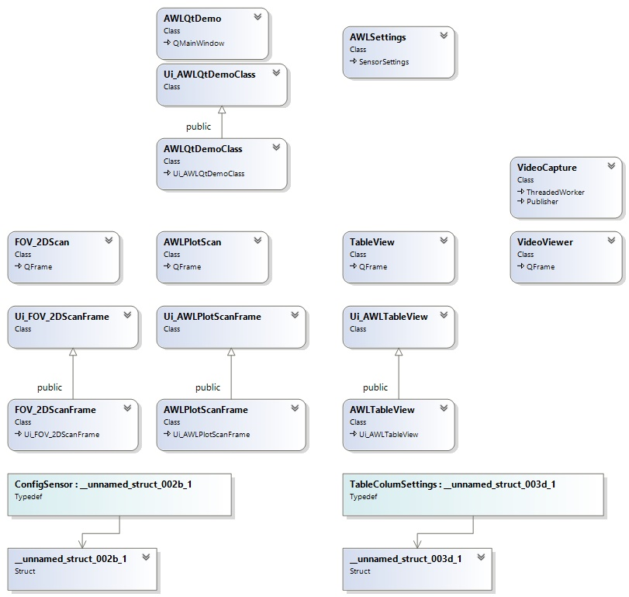
USEr interface hierarchy
Some UI classes are automatically generated by Qt. These do not integrate any documentation.

Slide 29
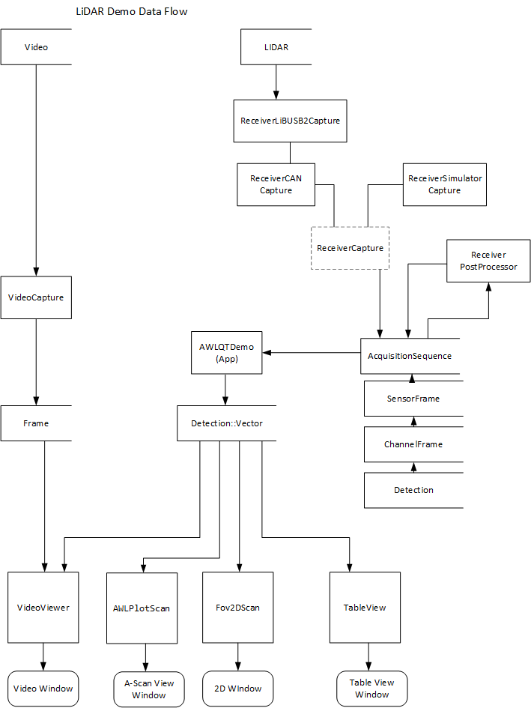
USER Interface - Dataflow

